Slide 1

Design and Control of the Lift Subsystem of a Two-Wheeled Forklift Robot
f
Content
I. Introduction
II. Lift mechanical design
III. Modeling
IV. Control
V. Simulation results
VI. Conclusions and Future Work
Sergio Esteban Quintero Benavides
Keio University
Faculty of Science and Technology
School of Integrated Design Engineering
Murakami Laboratory
2nd year – Master’s degree
2025/08/06
Sergio Esteban Quintero Benavides
1

Slide 2

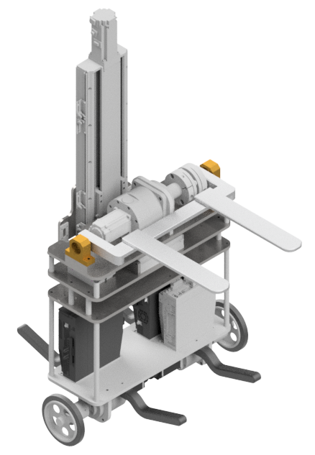

I. Introduction
Two-Wheeled Forklift Robot:
Aimed for load movement in warehouses.
Self-balanced mobile robot.
Small footprint.
[C]
2025/08/06
Sergio Esteban Quintero Benavides
2

Slide 3
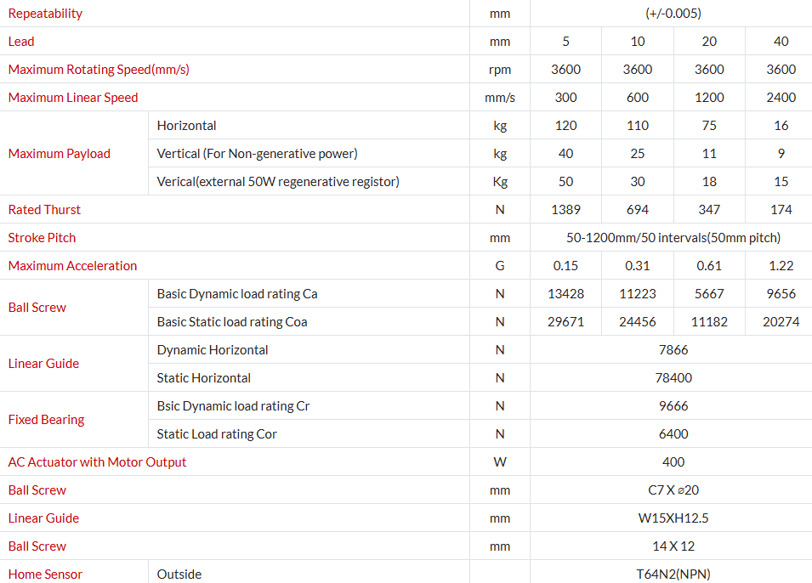
II. Lift mechanical design
Ball screw linear actuator ETH2-17-L5-350-BC-M40B-E5N5L
[19]
2025/08/06
Sergio Esteban Quintero Benavides
3

Slide 4
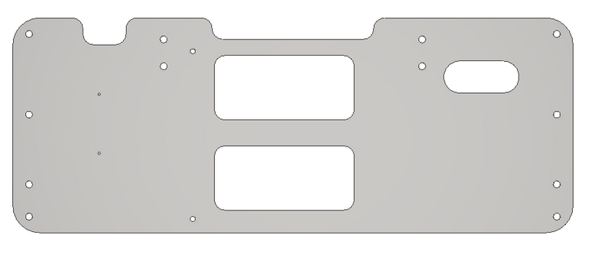
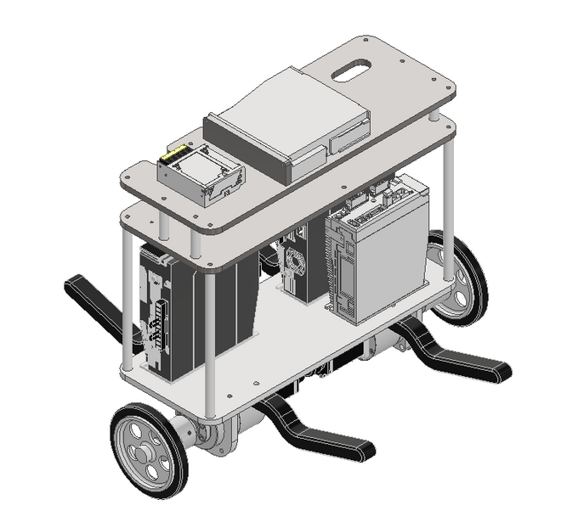
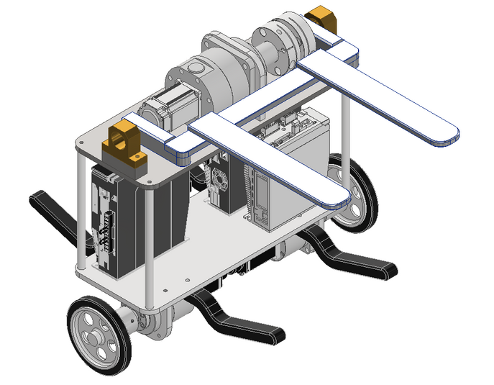
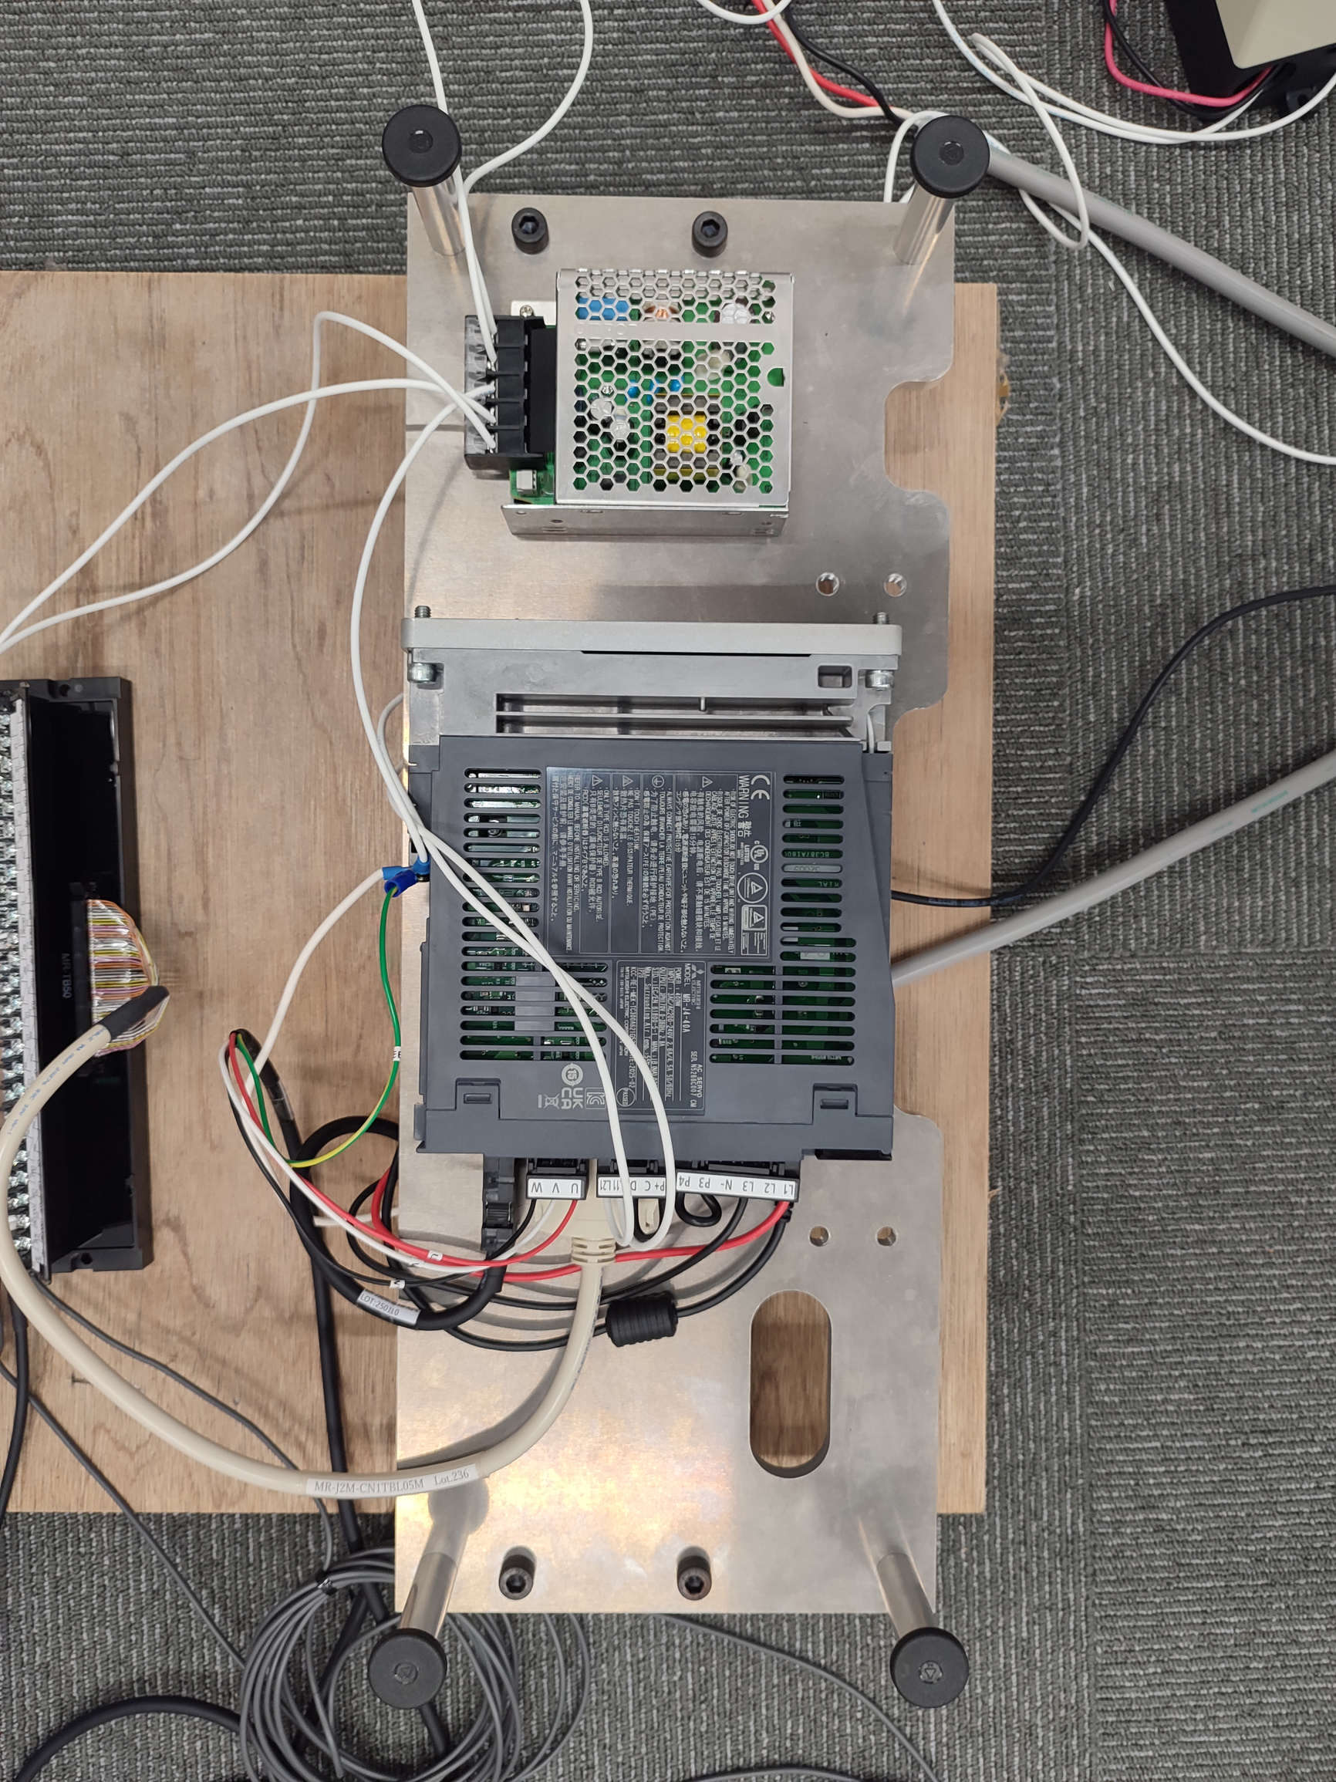
II. Lift mechanical design
2025/08/06
Sergio Esteban Quintero Benavides
4

Slide 5

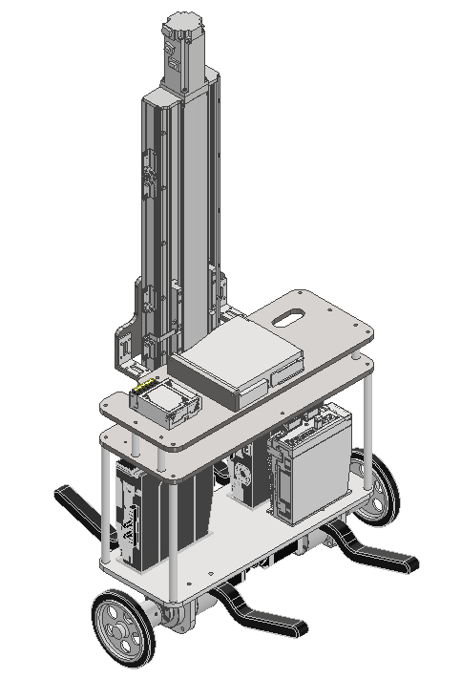
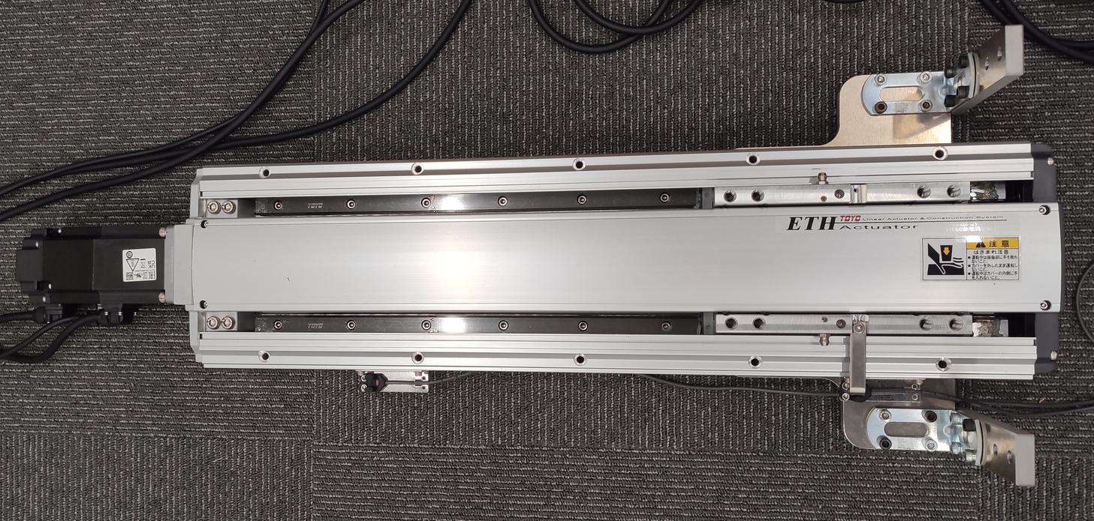
II. Lift mechanical design
2025/08/06
Sergio Esteban Quintero Benavides
5

Slide 6
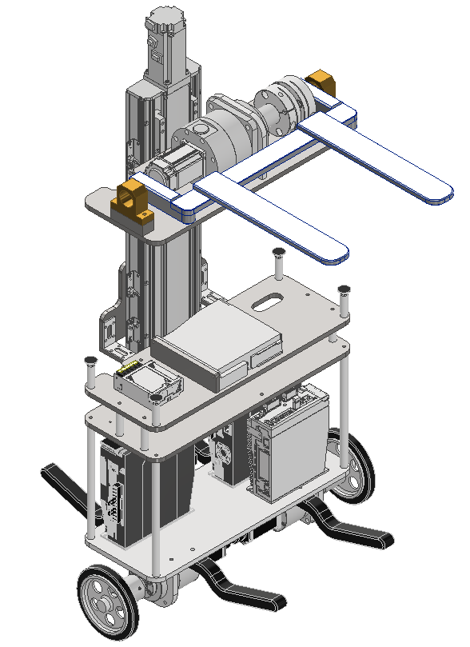
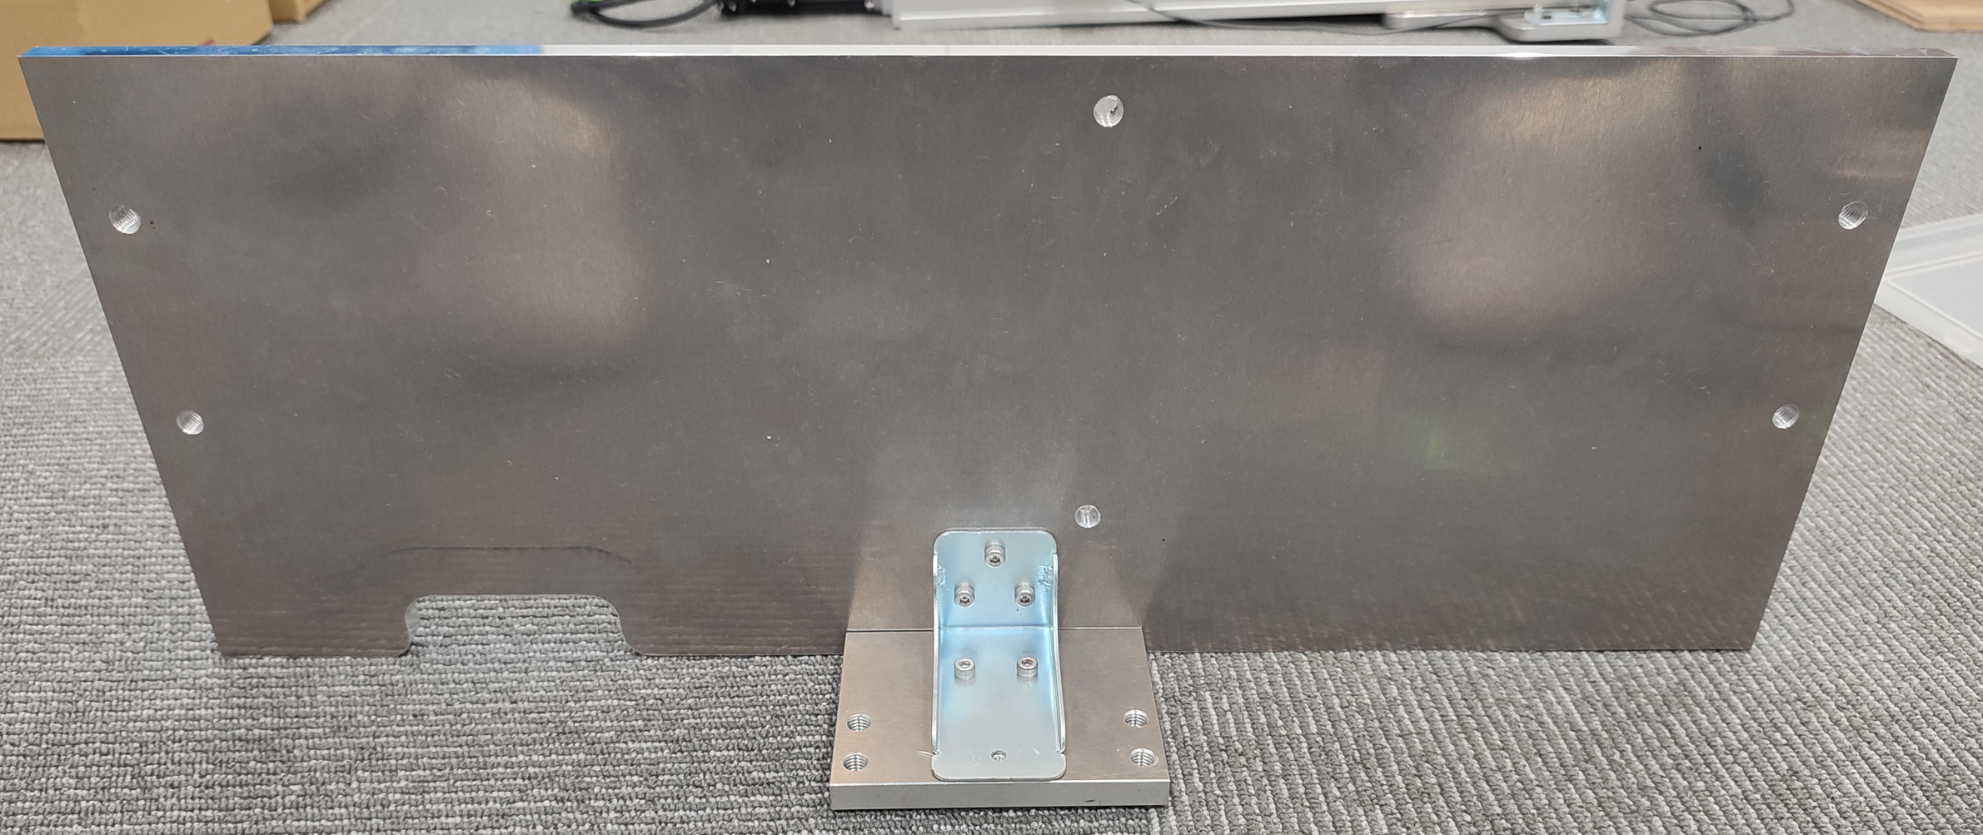
II. Lift mechanical design
2025/08/06
Sergio Esteban Quintero Benavides
6

Slide 7
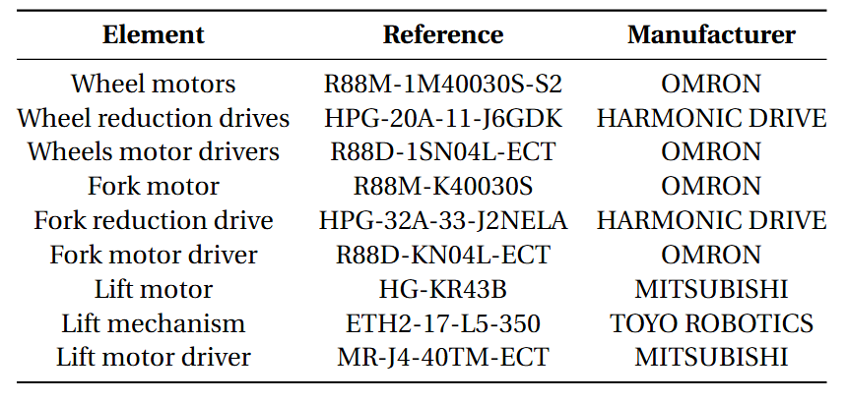
II. Lift mechanical design
2025/08/06
Sergio Esteban Quintero Benavides
7

Slide 8
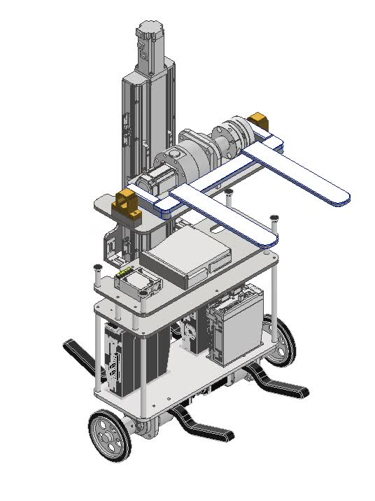
II. Lift mechanical design
2025/08/06
Sergio Esteban Quintero Benavides
8

Slide 9
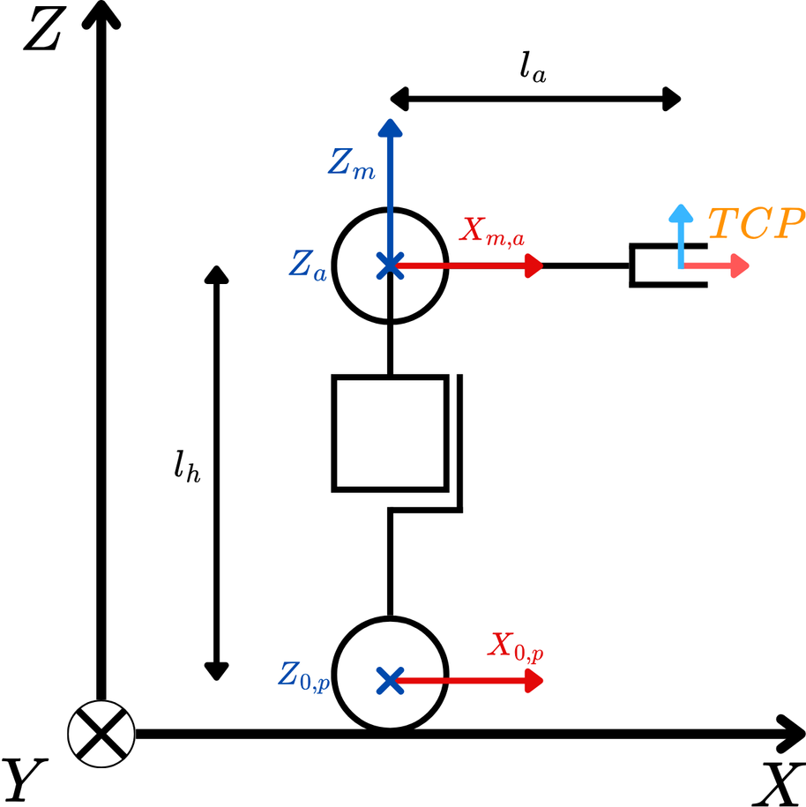
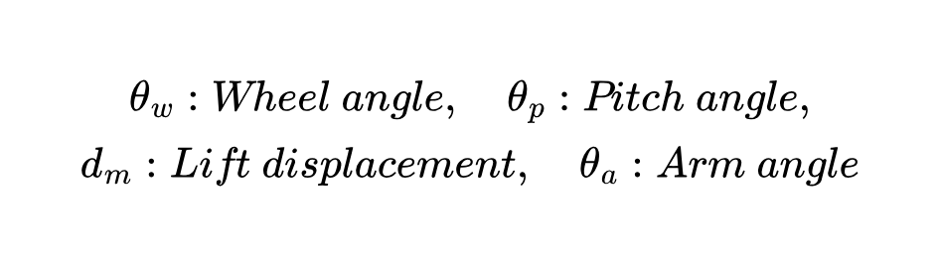
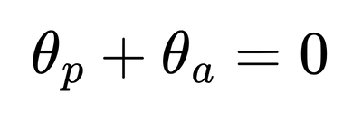
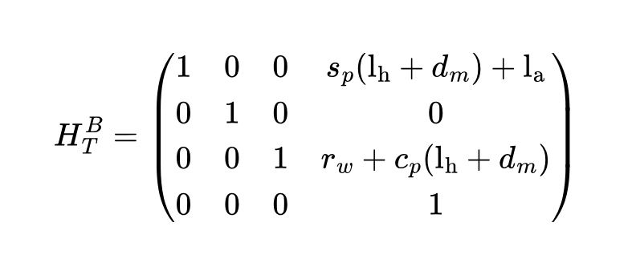
III. Modeling
Kinematics:
2025/08/06
Sergio Esteban Quintero Benavides
9

Slide 10
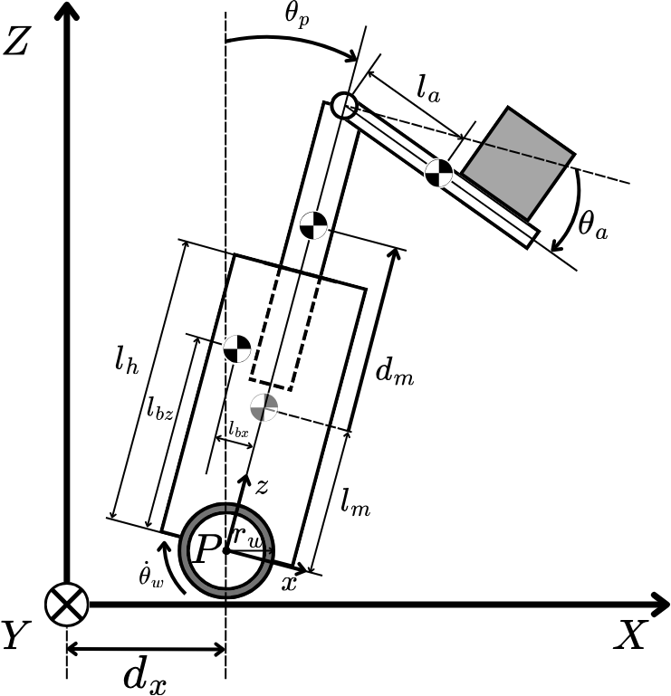
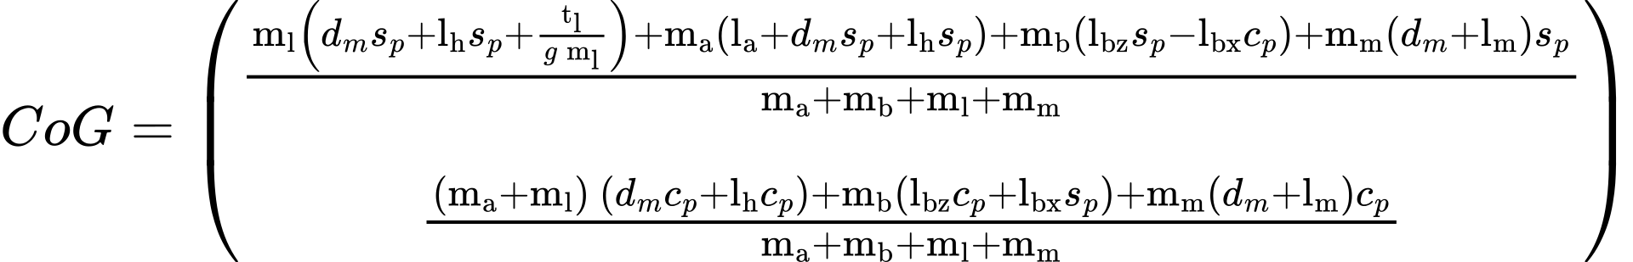
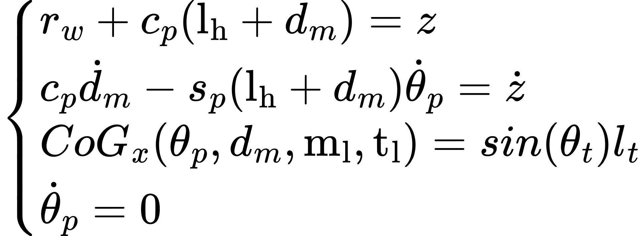
III. Modeling
Kinematics:
❖
2025/08/06
Sergio Esteban Quintero Benavides
10

Slide 11
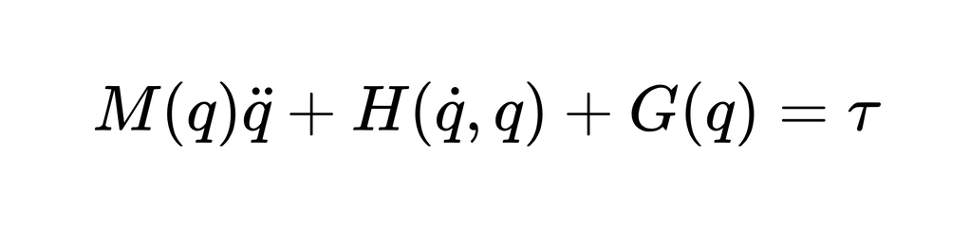
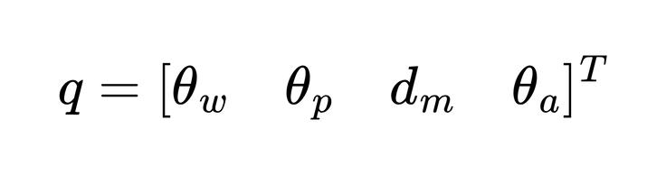
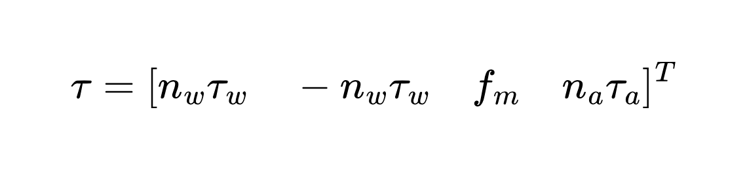
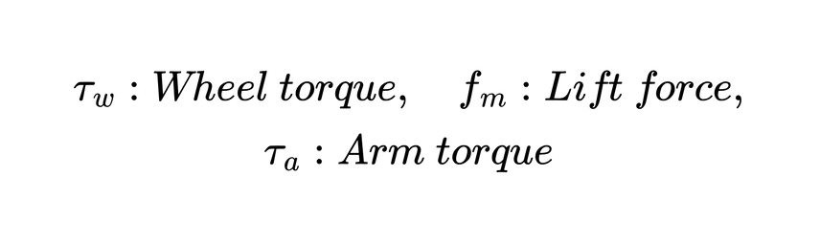
III. Modeling
Dynamics:
Generalized coordinates:
2025/08/06
Sergio Esteban Quintero Benavides
11

Slide 12
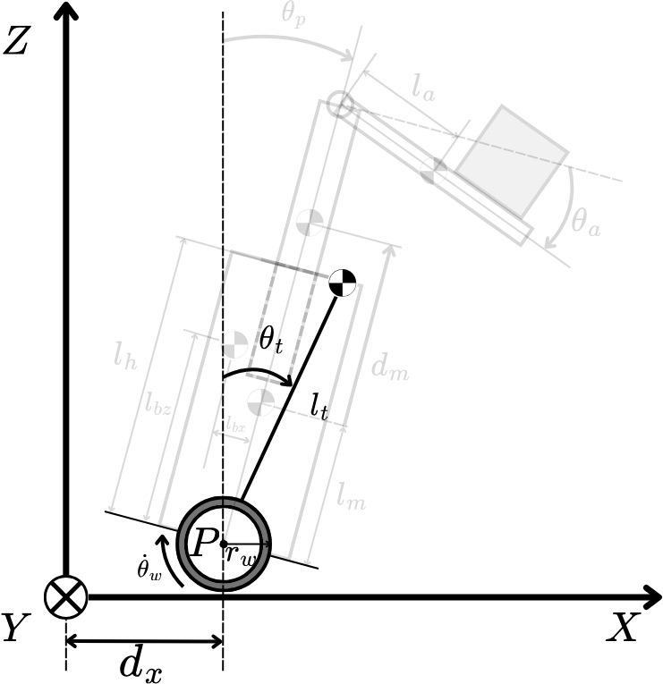
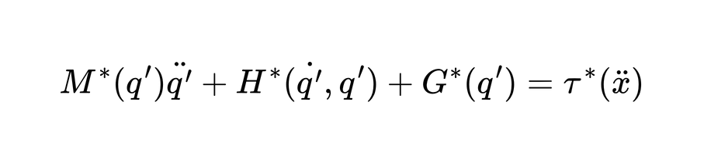
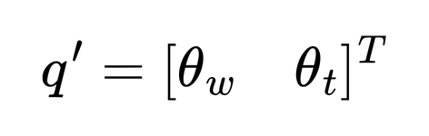
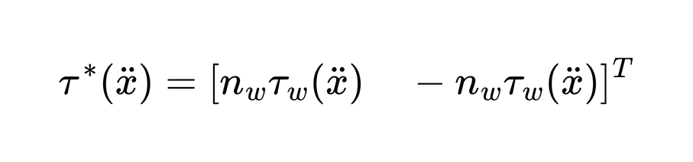
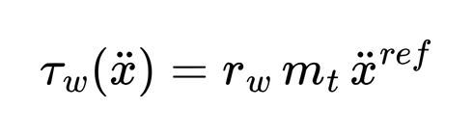
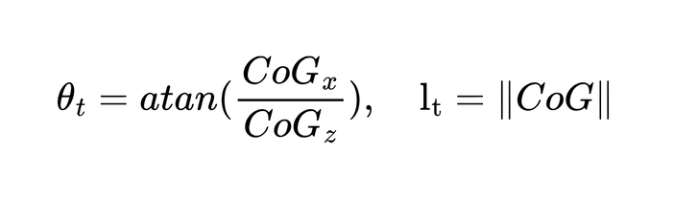
III. Modeling
Simplified dynamics:
❖
Generalized coordinates:
❖
2025/08/06
Sergio Esteban Quintero Benavides
12

Slide 13
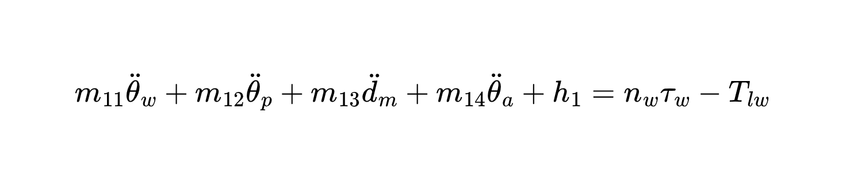
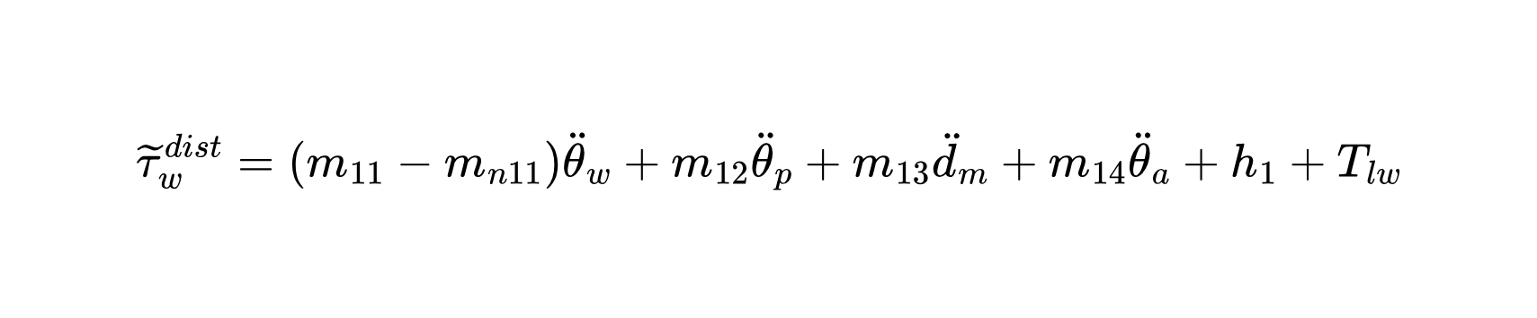
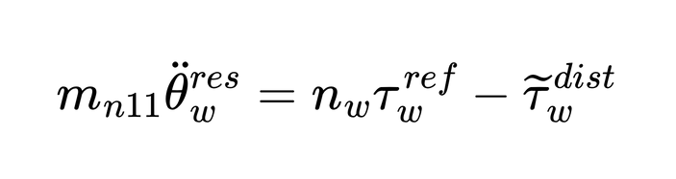
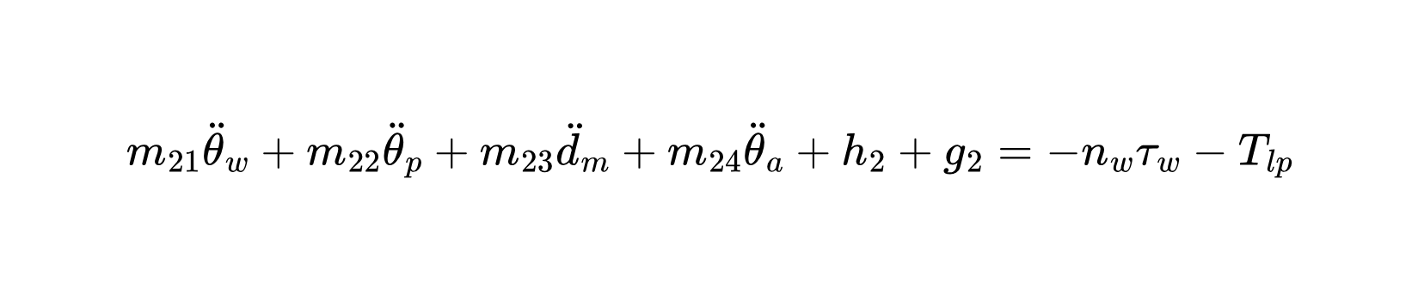
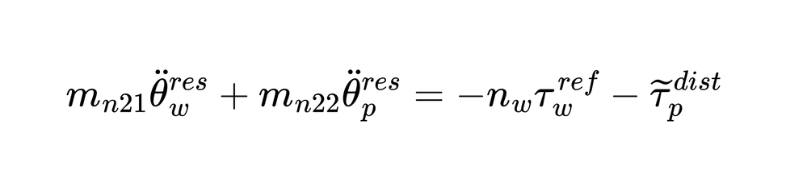
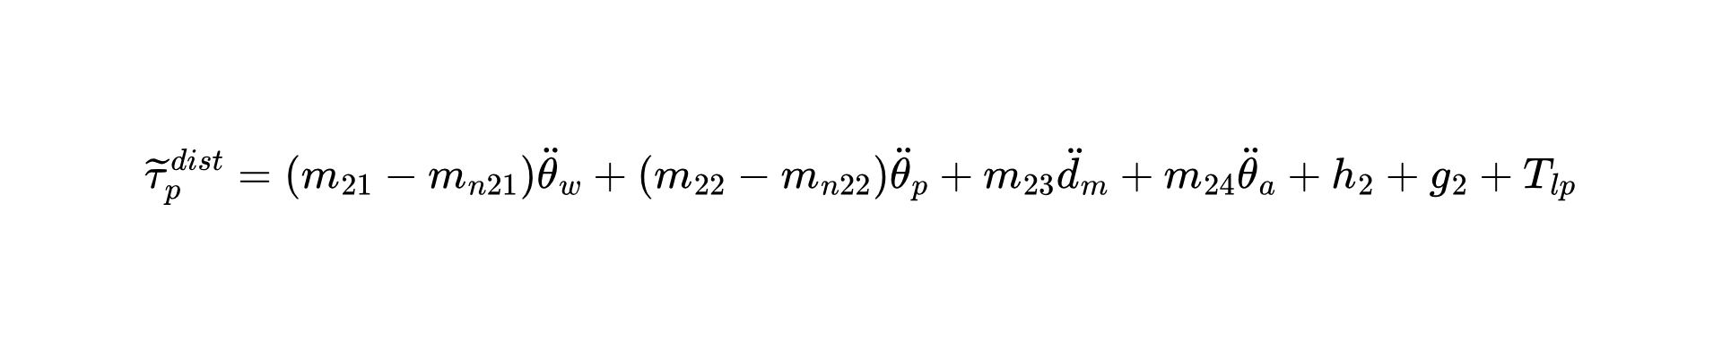
IV. Control
Synthesized Pitch Angle Disturbance Observer (SPADO):
2025/08/06
Sergio Esteban Quintero Benavides
13

Slide 14
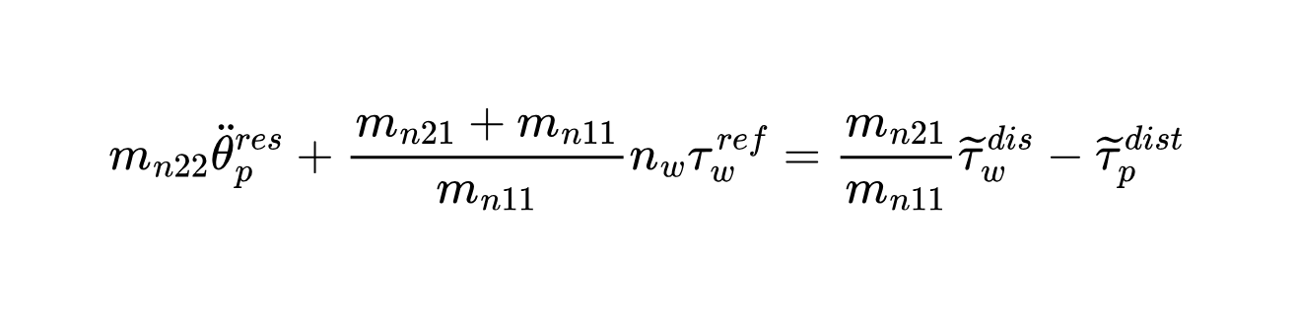
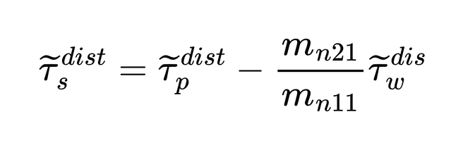
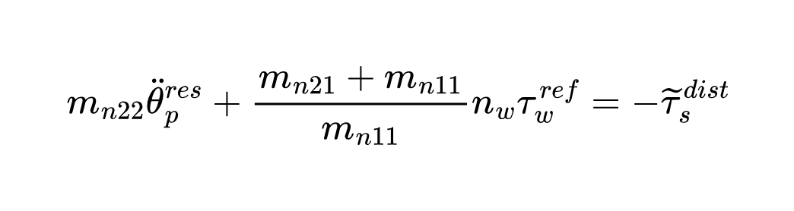
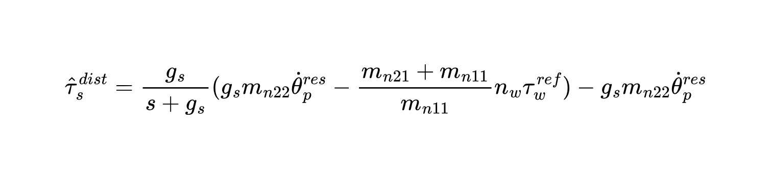
IV. Control
SPADO:
Pseudo differentiation
2025/08/06
Sergio Esteban Quintero Benavides
14

Slide 15
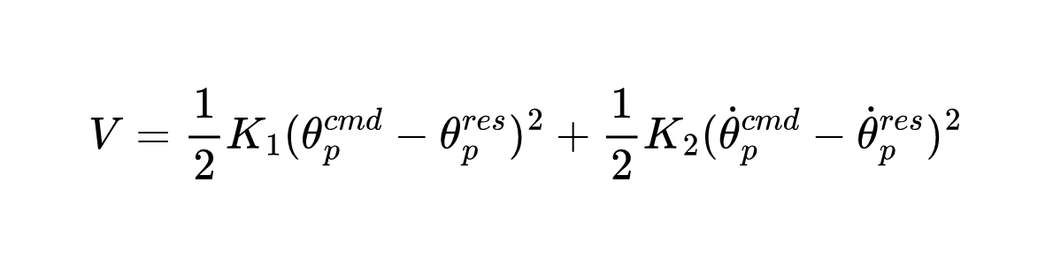
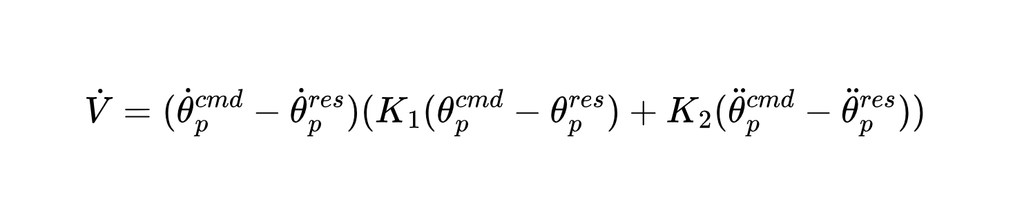
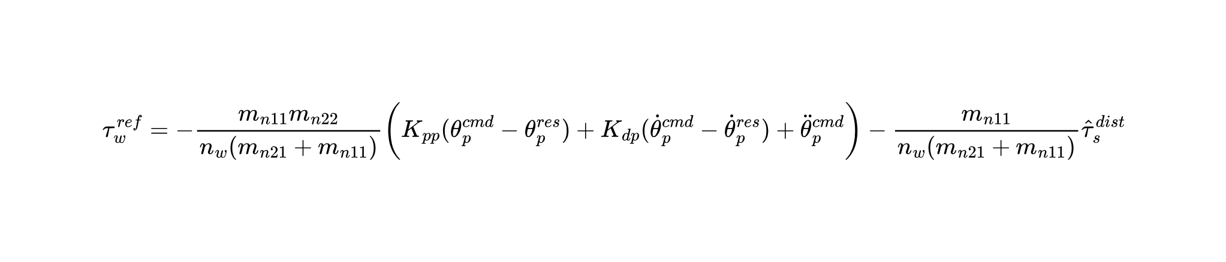
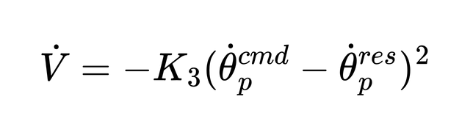
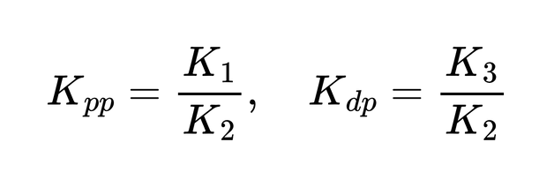
IV. Control
PD controller pitch angle:
2025/08/06
Sergio Esteban Quintero Benavides
15

Slide 16
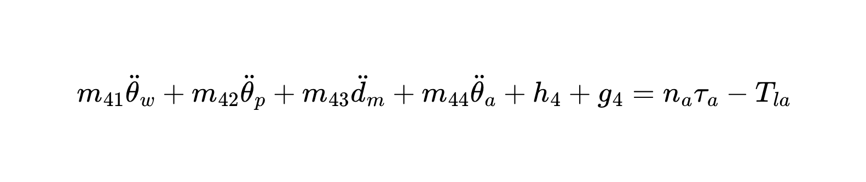
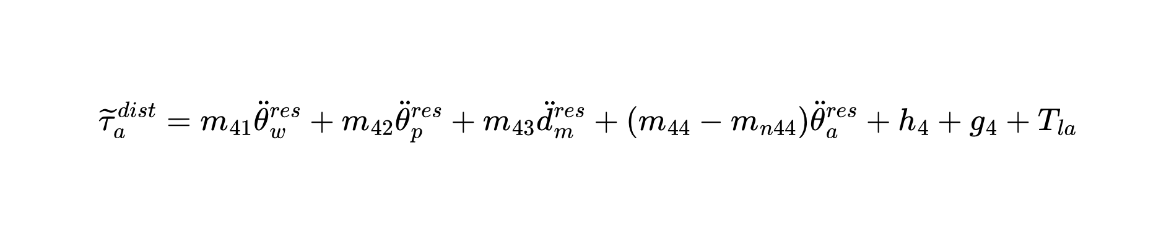
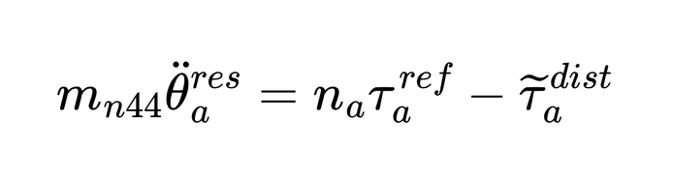
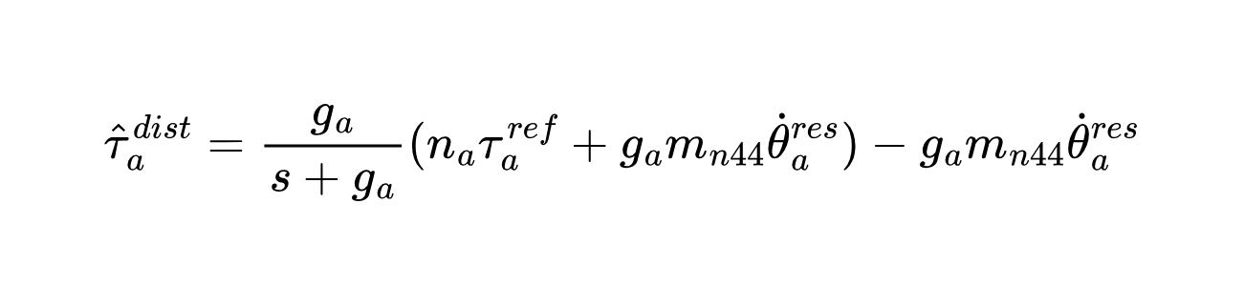
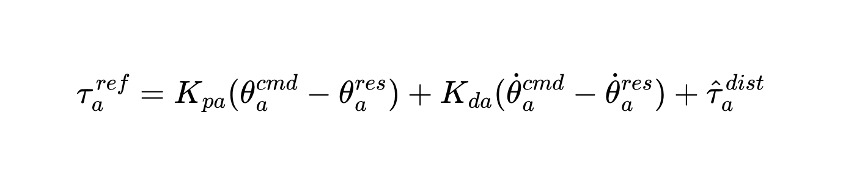
IV. Control
Fork Disturbance Observer (FDOB):
Pseudo differentiation
PD controller fork angle:
2025/08/06
Sergio Esteban Quintero Benavides
16

Slide 17
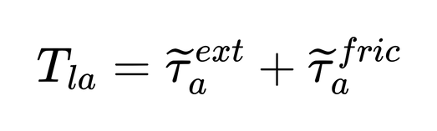




IV. Control
Fork Reaction Torque Observer (FRTOB):
Pseudo differentiation
2025/08/06
Sergio Esteban Quintero Benavides
17

Slide 18





IV. Control
Lift Disturbance Observer (LDOB):
Pseudo differentiation
PD controller lift displacement:
2025/08/06
Sergio Esteban Quintero Benavides
18

Slide 19





IV. Control
Lift Reaction Force Observer (LRFOB):
Pseudo differentiation
2025/08/06
Sergio Esteban Quintero Benavides
19

Slide 20


IV. Control
Wheel Position Control:
Total pitch command:
2025/08/06
Sergio Esteban Quintero Benavides
20

Slide 21

IV. Control
Control
Architecture:
❖
2025/08/06
Sergio Esteban Quintero Benavides
21

Slide 22

IV. Control
Physical implementation:
2025/08/06
Sergio Esteban Quintero Benavides
22

Slide 23


V. Results
2025/08/06
Sergio Esteban Quintero Benavides
23

Slide 24

V. Simulation results
2025/08/06
Sergio Esteban Quintero Benavides
24

Slide 25

V. Simulation results
Horizontal displacement of the robot
2025/08/06
Sergio Esteban Quintero Benavides
25

Slide 26

V. Simulation results
Position error of the robot
2025/08/06
Sergio Esteban Quintero Benavides
26
Notes:
Trans Error: 14.7cm
Std Error: 1.7cm

Slide 27

V. Simulation results
Horizontal velocity of the robot
2025/08/06
Sergio Esteban Quintero Benavides
27

Slide 28

V. Simulation results
Vertical position of the fork
2025/08/06
Sergio Esteban Quintero Benavides
28

Slide 29

V. Simulation results
Position error of the fork
2025/08/06
Sergio Esteban Quintero Benavides
29
Notes:
Trans Error: 7.58mm
Std Error: 0.3mm

Slide 30

V. Simulation results
Estimated external torque over the fork (18.142Nm)
2025/08/06
Sergio Esteban Quintero Benavides
30

Slide 31

V. Simulation results
Estimated mass of the external load (5kg)
2025/08/06
Sergio Esteban Quintero Benavides
31

Slide 32
VI. Conclusions and Future work
The proposed motion planning and control strategies allow the TWFR to execute trajectories in the X and Z coordinate axes simultaneously with an admissible position error.
The implementation of adaptive IK and ID solutions that depend on the estimation of physical properties of the external load provides great flexibility in industrial environments where it is not possible to control the variables of the load that will be manipulated.
The next steps for this work are the construction of the lift subsystem and the physical implementation of the presented motion planning and control algorithms.
2025/08/06
Sergio Esteban Quintero Benavides
32

Slide 33
References
[1] P. K. W. Abeygunawardhana, M. Defoort, and T. Murakami, “Self-sustaining control of two-wheel mobile manipulator using sliding mode control”, The 11th IEEE International Workshop on Advanced Motion Control, Mar. 2010. DOI: 10.1109/amc.2010.5464027.
[2] N. G. K. V. Shihabudheen and G. Dileep, “Applying h-infinity for stability control in two wheeled mobile manipulator”, 2015 International Conference on Soft Computing Techniques and Implementations- (ICSCTI), Oct. 2015. DOI: 10.1109/ICSCTI.2015.7489561.
[3] J. Ito and T. Murakami, “Underactuated control for two-wheeled mobile robot with an arm using torque constraint conditions and disturbance observer”, 2023 IEEE 32nd International Symposium on Industrial Electronics (ISIE), Jun. 2023. DOI: 10.1109/ISIE51358.2023.10228153.
[4] H. Kanazawa, K. Ishizaki, Y. Miyata, M. Nawa, N. Kato, and T. Murakami, “Model-based pitch angle compensation for center of gravity variation in underactuated system with an arm”, 2023 IEEE 32nd International Symposium on Industrial Electronics (ISIE), Jun. 2023. DOI: 10.1109/ISIE51358.2023.10228009.
[5] IEEE, Handle, (accessed Nov.1, 2023): https : / / robotsguide . com / robots /handle.
[6] F. I. for Material Flow-and-Logistics IML, Evobot - the evolution of autonomous mobile robotic systems, (Accessed Nov.1, 2023): https://www.iml.fraunhofer.de/en/fields_of_activity/material-flow-systems/iot-and-embedded-systems/evobot.html.
[7] Y. Nagatsu and H. Hashimoto, “Force control for vehicle robot with inverted two wheeled and stable travelling modes”, IECON 2019 - 45th Annual Conference of the IEEE Industrial Electronics Society, 2019. DOI: 10.1109/iecon.2019.8926672.
[8] A. Gopinath and V. R. Jisha, “Gain scheduled lqr control of a two wheeled mobile robot with heavy payloads”, 2022 IEEE International Conference on Signal Processing, Informatics, Communication and Energy Systems (SPICES), Mar. 2022. DOI: 10.1109/spices52834.2022.9774265.
2025/08/06
Sergio Esteban Quintero Benavides
33

Slide 34
References
[9] V. Klemm and et al., “Ascento: A two-wheeled jumping robot”, 2019 International Conference on Robotics and Automation (ICRA), May 2019. DOI: 10.1109/icra.2019.8793792.
[10] S. Wang and et al., “Balance control of a novel wheel-legged robot: Design and experiments”, 2021 IEEE International Conference on Robotics and Automation (ICRA), May 2021. DOI: 10.1109/icra48506.2021.9561579.
[11] E. Ackerman, Tencent’s new wheeled robot flicks its tail to do backflips, (Accessed Nov.1, 2023): https://spectrum.ieee.org/tencents- new- wheeled- robot- flicks-its-tail-to-do-backflips.
[12] F. Raza, W. Zhu, and M. Hayashibe, “Balance stability augmentation for wheel-legged biped robot through arm acceleration control”, IEEE Access, Apr. 2021. DOI:10.1109/access.2021.3071055.
[13] X. - S. Gao, L. Yan, P. Zhao, N. Du, and S. Bu, “Inverse kinematics solution and analysis for multi-dof mobile manipulator”, 2022 IEEE 17th Conference on Industrial Electronics and Applications (ICIEA), Dec. 2022. DOI: 10.1109/ICIEA54703.2022.10006046.
[14] S. S. Mathew and V. R. Jisha, “Tracking control of a mobile manipulator with external torque disturbances using computed torque control”, 2020 IEEE 17th India Council International Conference (INDICON), Dec. 2020. DOI: 10.1109/INDICON49873.2020.9342099.
[15] N. Tan, Z. Zhu, and P. Yu, “Neural-network-based control of wheeled mobile manipulators with unknown kinematic models”, 2020 International Symposium on Autonomous Systems (ISAS), Dec. 2020. DOI: 10.1109/ISAS49493.2020.9378850.
[16] E. Vollenweider, M. Bjelonic, V. Klemm, N. Rudin, J. Lee, and M. Hutter, “Advanced skills through multiple adversarial motion priors in reinforcement learning”, 2023 IEEE International Conference on Robotics and Automation (ICRA), May 2023. DOI:10.1109/icra48891.2023.10160751.
2025/08/06
Sergio Esteban Quintero Benavides
34

Slide 35
References
[17] C. Schwarke, V. Klemm, M. v. d. Boon, M. Bjelonic, and M. Hutter, “Curiosity-driven learning of joint locomotion and manipulation tasks”, in Proceedings of The 7th Conference on Robot Learning, J. Tan, M. Toussaint, and K. Darvish, Eds., ser. Proceedings of Machine Learning Research, vol. 229, PMLR, Jun. 2023, pp. 2594–2610. [Online]. Available: https://proceedings.mlr.press/v229/schwarke23a.html.
[18] E. Sihite, A. Kalantari, R. Nemovi, A. Ramezani, and M. Gharib, “Multi-modal mobility morphobot (M4) with appendage repurposing for locomotion plasticity enhancement”, Nature Communications, vol. 14, no. 1, 2023. DOI: 10.1038/s41467-023-39018-y.
[19] TOYO Automation Co., Ltd. “ETH2 - 17 Series, in TOYO Electric Actuator Total Catalog Vol. 16, pp. 14–19”. Accessed: 2025-07-02. (2025), [Online]. Available: https://www.toyorobot.com/File/Fsrv_NoAuthority_Download/f25011613132034.
[A] https://www.flaticon.com/free-icons/comparison
[B] https://www.flaticon.com/free-icons/standard
[C] https://www.flaticon.com/free-icons/storage
2025/08/06
Sergio Esteban Quintero Benavides
35

Slide 36
Thank you!
2025/08/06
Sergio Esteban Quintero Benavides
36

